Slide 1
AL1x4x Setting IP Address
Configuring the AL1x4x IO-Link module
Set AL1x4x IP- address

Slide 2
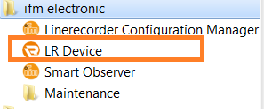

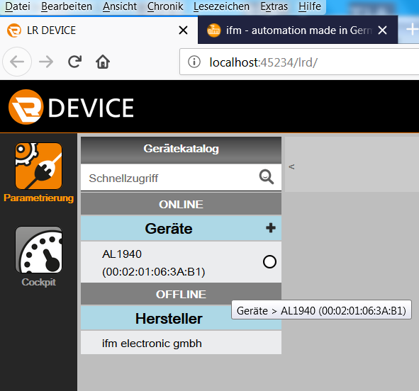
AL1x4x Setting IP Address
Open LR Device software
Scan Device
Check if IoT- port is connected !

Slide 3
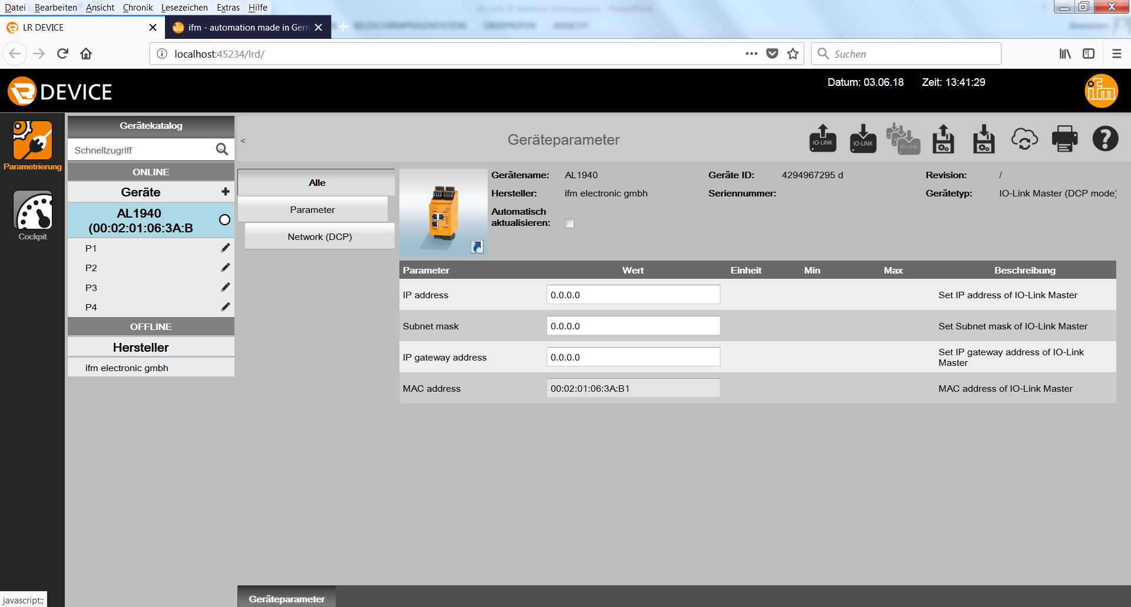
AL1x4x Setting IP Address
3. Read Device Parameter

Slide 4
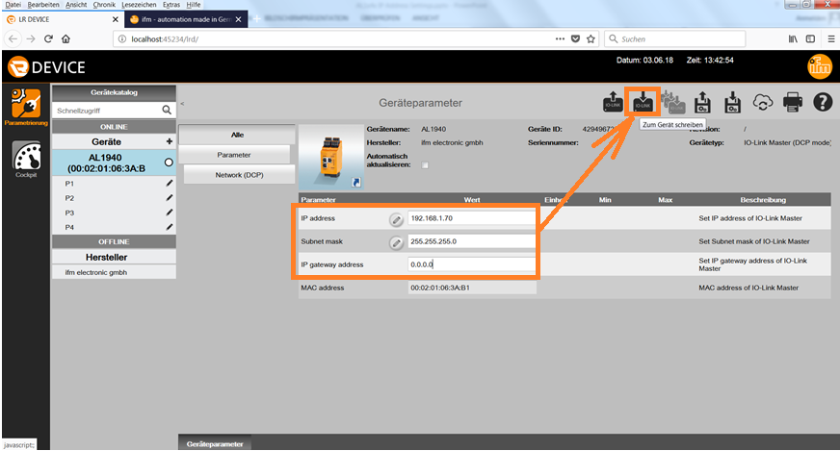
AL1x4x Setting IP Address
4. Change IP- Address of IoT- port and write to device

Slide 5
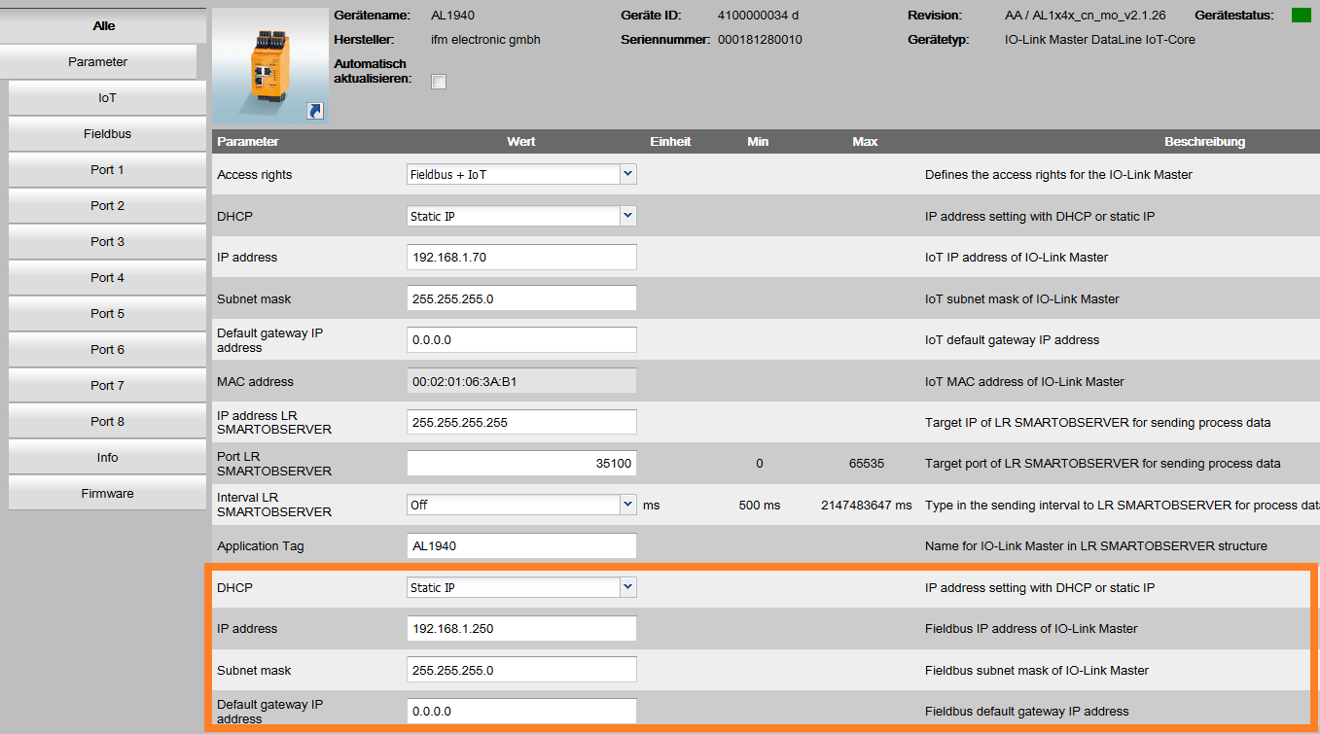

AL1x4x Setting IP Address
5. Change IP- Address of Modbus port and write to device
Check if IoT- port is connected !

